Slide 1



Yr 2 Curriculum Meeting
Wednesday 23rd September
2026

Slide 2

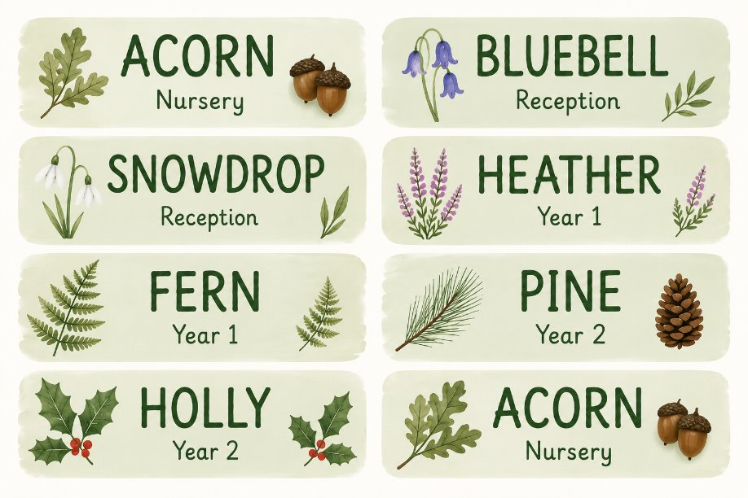
Welcome to Year 2
Teacher: Miss Berry Mrs Botting Miss Sawyer PPA Miss Petre PPA Mrs Hulland | Teacher: Mrs Harvey Mrs Webb Miss Sawyer PPA Miss Petre PPA Mrs Hulland

Slide 3
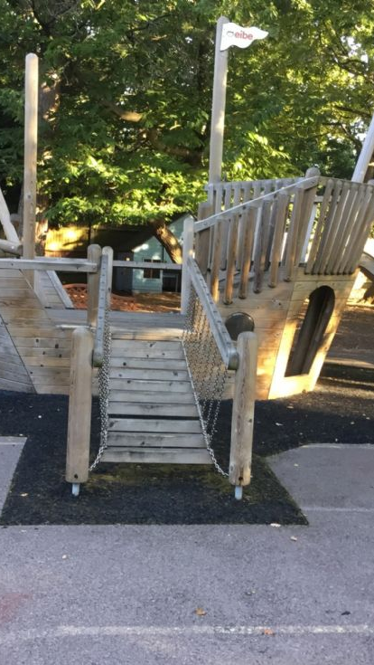
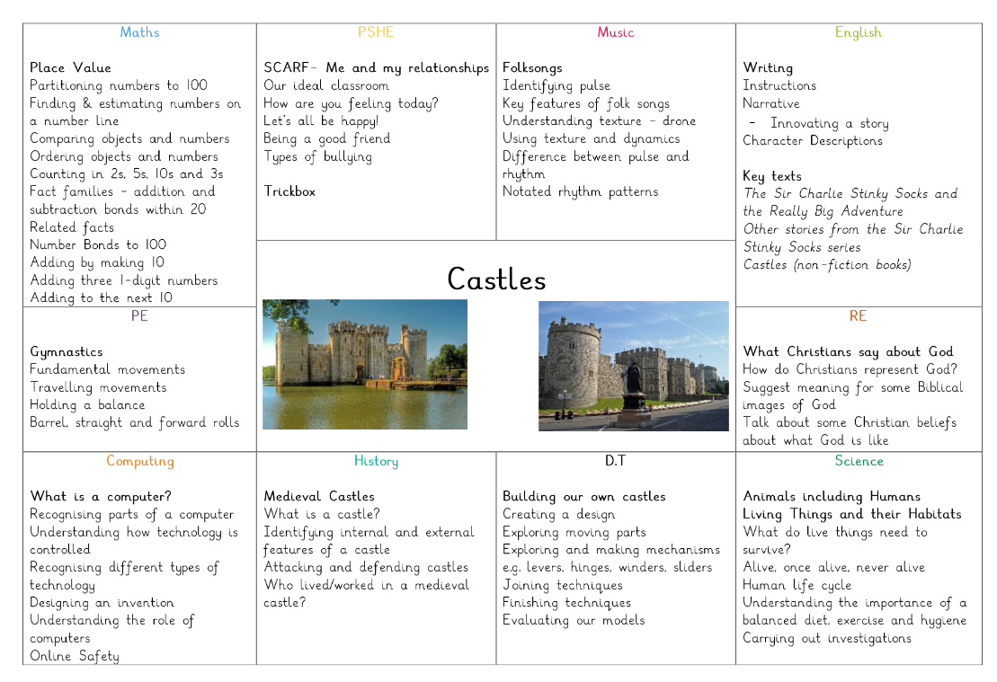
Year 2 Curriculum
More information on what your child is learning throughout the year can be found on our website.
https://www.crawleyridge.co.uk/page/?title=Year+2&pid=297
Notes:
Brief overview of the Curriculum.
Year 2 will be going to The Living Rainforest and Legoland to accompany the Curriculum.

Slide 4
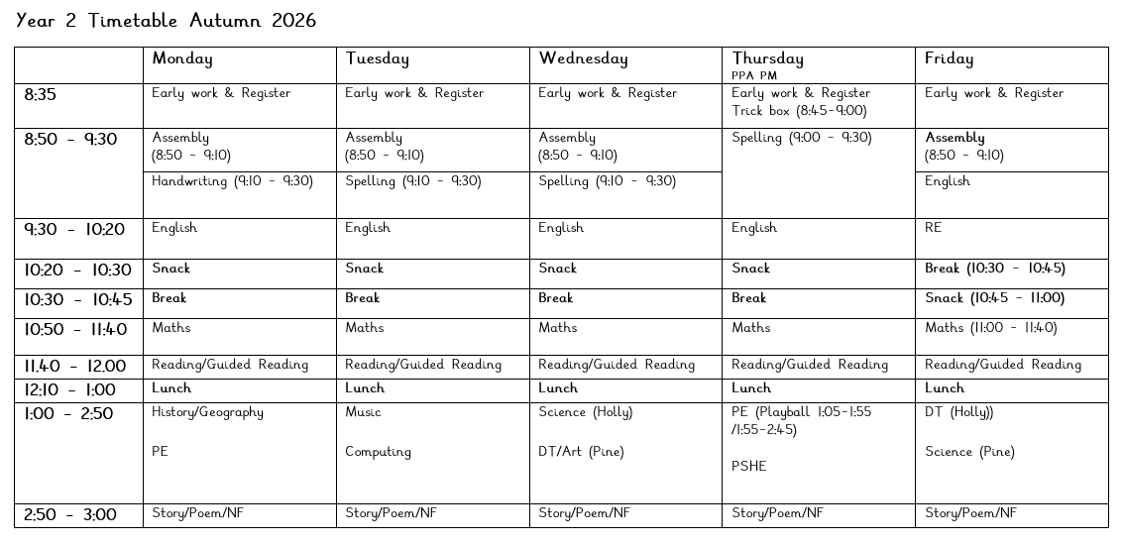
Year 2
What a week in Year 2 looks like.

Slide 5
Statutory Assessments
How will your child be assessed in Year 2?
There are no longer any formal Statutory Assessments in Year 2.
Teacher assessments will build up a picture of ability throughout the year.​
In the summer term, the children will be assessed against the National Framework for English Reading, English Writing, Mathematics and Science. They must be secure in every strand to achieve the expected standard for each subject. ​
Teacher assessments will be reported to parents at the end of summer term in your child’s report.​
Any child who did not achieve the expected standard for phonics in Year 1 will have the opportunity to sit the phonics check again in Year 2.

Slide 6

Our School Policy on Reading
We will send home reading books appropriate to your child’s level of reading.
What to do with your child’s reading book:
Read it frequently. (Short bursts of frequent reading are most effective)
Each book should be read at least three times to help with fluency and understanding.
Books will be changed once a week in Yr R if read at least 2 times, Yr 1 . In Yr 2, books will be changed once they have been read at least 3 times.
Please write in your child's reading record.
Bring books and reading records in every day.
At the front of most of the books you will find the sounds which are being focused on throughout the story for children reading decodable books.
At the back of the book are questions to help develop understanding of the story.
A small sticker will be stuck on the back of your child's reading record when they have been heard read by an adult at home 3 times in a week and this is recorded in their reading record.
Notes:
In school, we support reading with the teaching of phonics, guided reading, individual reading, end of the day story, weekly trips to the library. We ask that families read aloud to their children at least once a day and listen to their child read at least 3 times a week.
Children will have new oxford owl log ins.

Slide 7
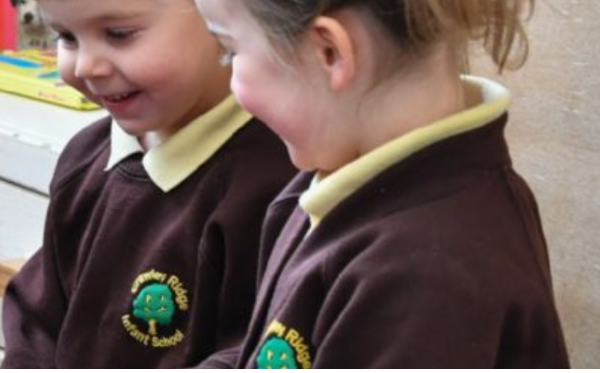
Our School Policy on Uniform
Children should attend school in the correct uniform.
Please ensure your child is wearing:
Coat with hood and hanging loop
Dark brown pinafore or skirt
Grey trousers or shorts
Lemon yellow polo shirt with school logo
Brown sweatshirt or cardigan with school logo
Grey or white socks
Brown tights
Black school shoes with good grip
Lemon yellow summer dress with white stripes or gingham pattern
Please ensure your child brings:
Coat with hood and hanging loop
Green book bag with school logo (only 1 small keyring)
Water bottle
A hat and gloves in the winter
A sun hat in the summer
Simple watches are permitted. Smart watches, of any kind, are strictly prohibited.
Please ensure your child does not wear jewellery, nail varnish or transfers to school.
For safety reasons please ensure long hair is tied back.
Simple hairbands and bobbles are permitted in school colours (brown, green, yellow.)
Please ensure all items are clearly labelled.
Notes:
Children should bring an appropriate coat everyday. We intend to use the outside areas in all weathers and this enables us to do so.
Please do not allow children to bring additional rucksacks as we have limited space in the cloakroom.
Please ensure the water bottle is filled with water only.
Smart watches are strictly prohibited for safeguarding reasons.

Slide 8

Our School Policy on P.E
P.E will take place twice a week in KS1
On P.E. days, please ensure your child is wearing:
Lemon yellow round neck t-shirt with school logo (optional)
Green PE shorts
Brown joggers
Grey or white socks
Trainers
Jewellery is not permitted to be worn during P.E.
If a child has pierced earrings, they must be removed for P.E. Children must be able to do this as staff are not permitted to do so.
For safety reasons please ensure long hair is tied back.
Simple hairbands and bobbles are permitted in school colours (brown, green, yellow.)
P.E. with your child's class teacher | P.E with Playball
Monday | Thursday (Autumn & Spring Term) Wednesday (Summer)
Notes:
Children are not permitted to wear jewellery for P.E. Earrings cannot be covered with plasters. Children will not be allowed to take part in the session for safety reasons if jewellery is worn.
We are incredibly lucky to have specialist P.E. coaches who provide excellent sports tuition for all pupils.

Slide 9
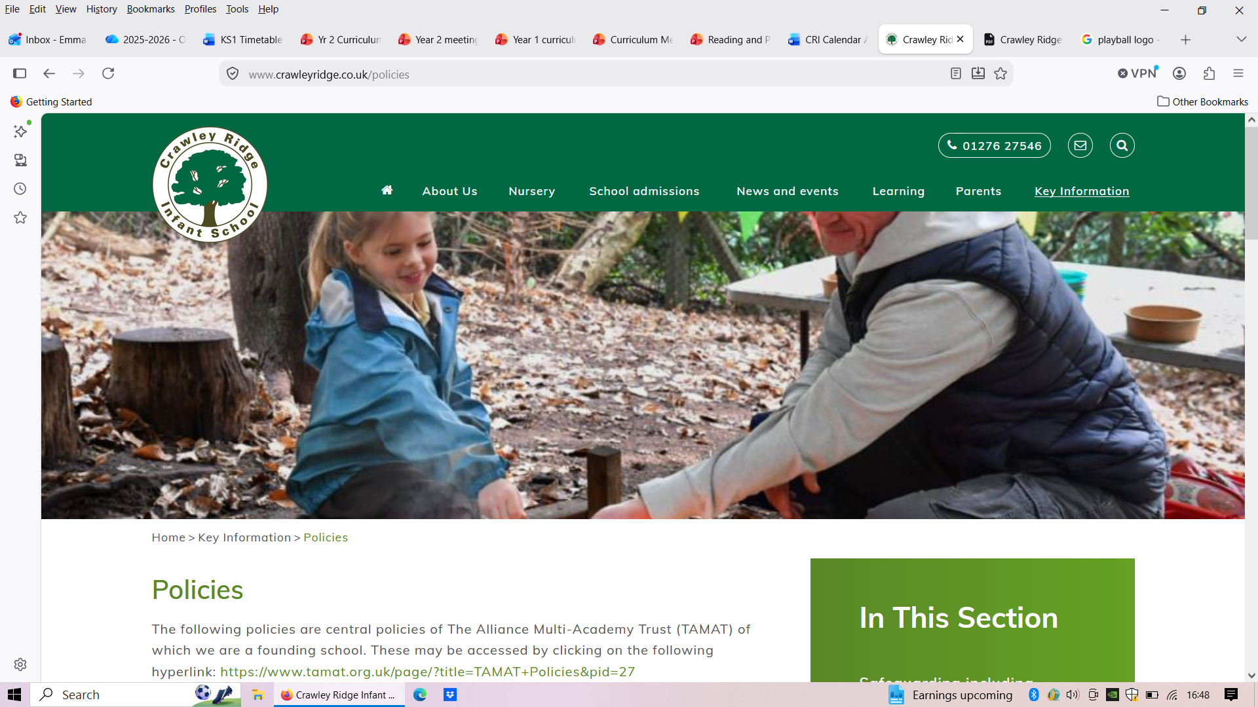
Our School Policy on Forest School
All children will have the opportunity to participate in Forest School with Mrs Reid
Forest School is an incredibly important part of the Crawley Ridge experience.
On Forest School days, please ensure your child is wearing:
Lemon yellow polo shirt with school logo
Brown sweatshirt or cardigan with school logo
Black or brown joggers or leggings
Grey socks
Trainers
Our PTA have provided all other outdoor wear required.
[Insert Forest School Timetable Here]
Notes:
Our Forest School is run by Mrs Reid a very passionate professional who is an expert at sharing her love of the outdoors with the pupils at Crawley Ridge.

Slide 10
Our School Policy on Homework
Spelling Home Learning and Projects
Spelling
The children will get a list of spelling words to practise every week based on the Go grapheme Grafters words from the spelling program or common exception words from the ELS program.
Projects
There are two exciting projects in Year 2. The children will make a model of a habitat in the Spring term and will complete the project of their choice in the Summer term.

Slide 11
General Reminders
Birthdays – children can wear their own clothes. No sweet treats.
Please let us know if somebody else is collecting your child and share your password with the adult collecting​.
Please ensure all items are clearly labelled.

